Slide 1
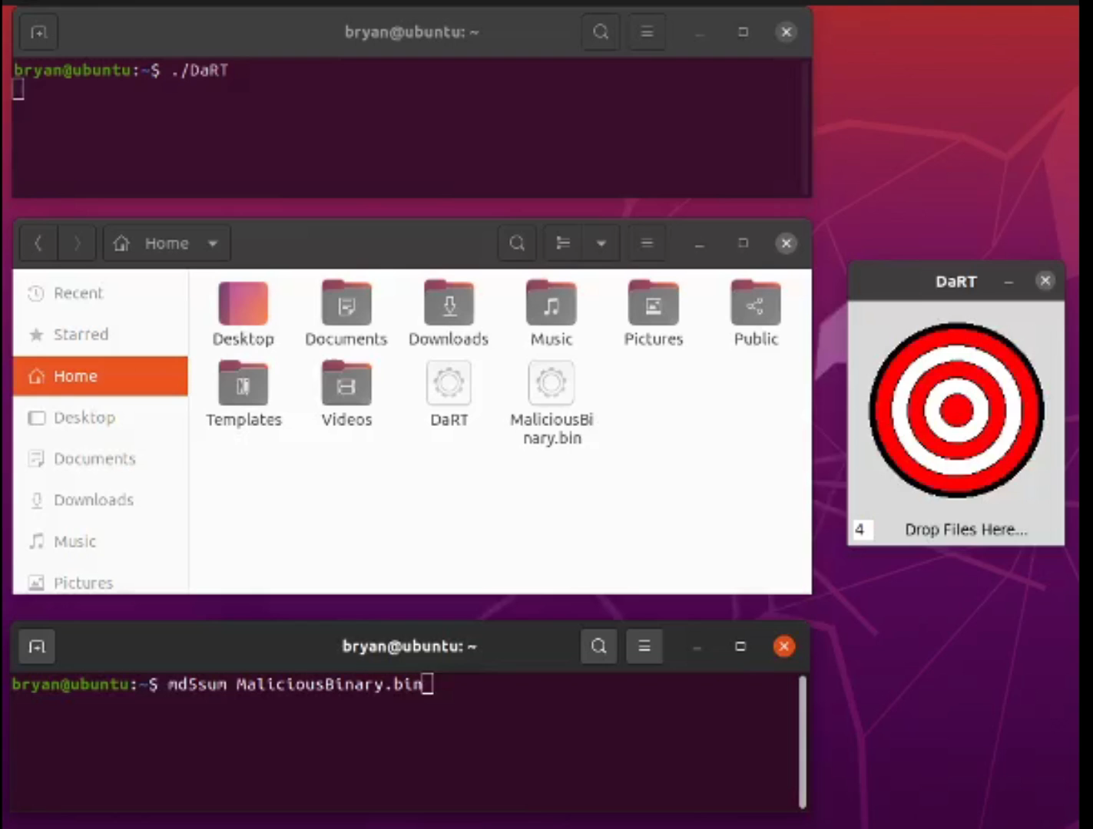
DaRT – Disassembly and Reassembly for Transport

Slide 2
DaRT – Disassembly and Reassembly for Transport
Byte 1
Binary
23 D7 0F 4D 73 56 AF CC…
Binary_Partial_2
Binary_Partial_1
59 2A 83 40 38 90 A7 60 BF…
Binary_Partial_0
4A 8F B1 42 80 A4 0E 91 78…

Slide 3
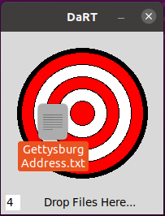
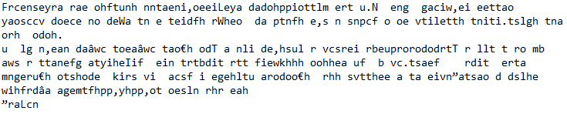
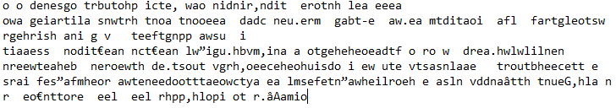
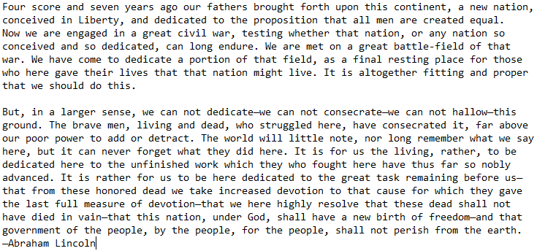
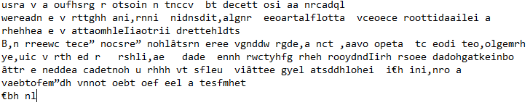
DaRT – Disassembly and Reassembly for Transport
GettysburgAddress.txt.dart
GettysburgAddress.txt_Partial_0
GettysburgAddress.txt_Partial_1
GettysburgAddress.txt
GettysburgAddress.txt_Partial_2

Slide 4
DaRT – Disassembly and Reassembly for Transport
Binary_Partial_1
Binary_Partial_2
23 D7 0F 4D 73 56 AF CC…
Binary_Partial_1
59 2A 83 40 38 90 A7 60 BF…
Binary_Partial_0
4A 8F B1 42 80 A4 0E 91 78…
Byte 1
Binary

Slide 5
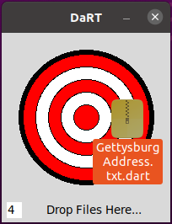
DaRT – Disassembly and Reassembly for Transport
GettysburgAddress.txt.dart
GettysburgAddress.txt_Partial_0
GettysburgAddress.txt_Partial_1
GettysburgAddress.txt
GettysburgAddress.txt_Partial_2

